Slide 1
Flight data analysis
Team 4
by Demidova D., Khuzina I., Kovylina G., Arinovich K., Smirnov G.

Slide 2
DIFFICULTIES
Absence of missing values => could not apply COALESCE with valuable results
Given time intervals could not be applied to the dataset with limited dates => used smaller time interval
Incomplete dataset:
Missing values for most tasks (airlines, flights boarded, misassigned arrivals and destinations, the table only had data for each individual person and not the flights) => generated synthetic data

Slide 3
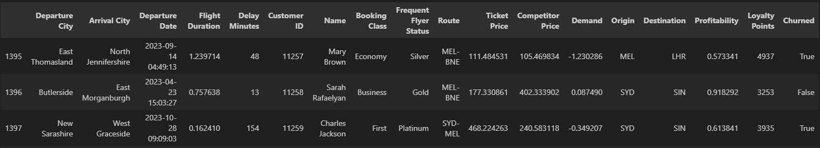
Data Generation
Additional passengers
1. agg by city and their data. We make a "profile" and some statistics for a city. Then, for similar data generation the following steps:
mode() - the most frequent departures to the given city, we take [0] as the number 1 most popular department.
2. A 1300 time cycle
- Take a random city and its characteristics
- We go to the end and select the last row + 1 to start adding new data
3. Initialize a dictionary with a new entry
- state values
4. Generate random choice of name
5. Concatenate with the initial DB
tail():

Slide 4
TASKS
1
Import data. Create unique flight identifiers and ensure all tables can be joined at flight level
Multiple JOIN types, COALESCE for missing values, key generation
2
For each route (origin-destination pair), calculate 3-day, 6-day, and 9-day rolling average demand (number of people who used it). Identify routes with improving/declining demand. Calculate load factor volatility (standard deviation over rolling windows).
Window AVG and STDDEV over time partitions by route
3
Create delay categories: on-time (<15 min), minor delay (15-60 min), major delay (60-180 min), severe delay (>180 min), cancellation. Calculate rolling on-time percentage by route and airline.
Date/time difference calculations, CASE for delay categories, window AVG of on-time flags

Slide 5
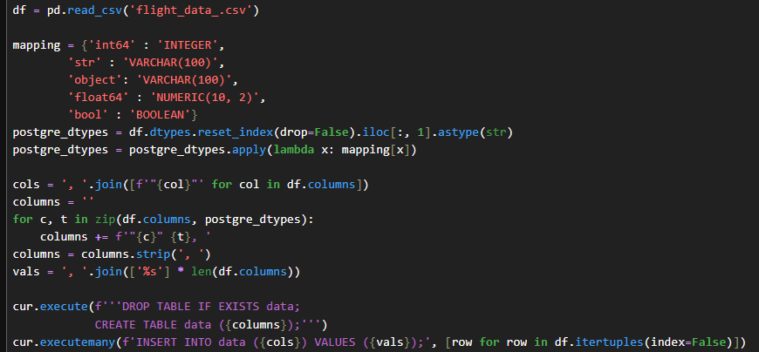
TASK 1 Importing dataset to SQL table
We loaded synthetic flight date from CSV to PostgreSQL by mapping pandas data types to PostgreSQL types, created main data table and inserted data using queries

Slide 6
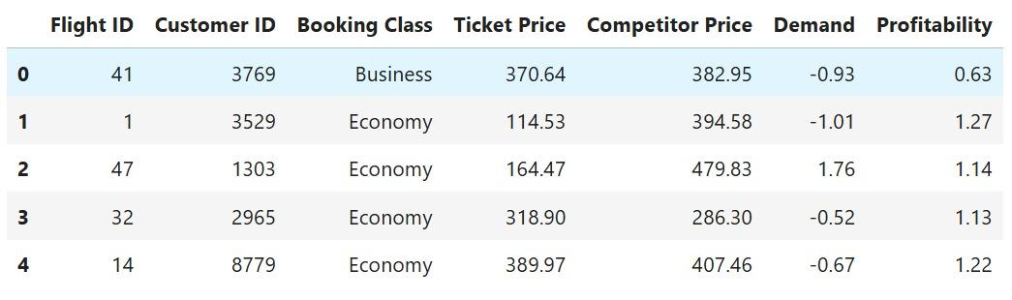
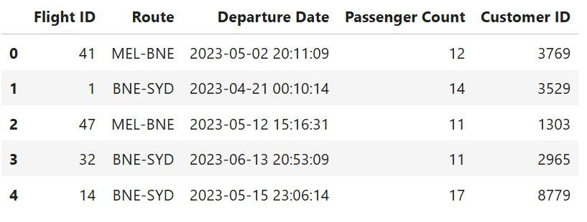

Slide 7
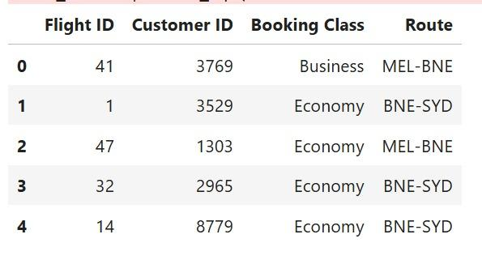

Slide 8
TASK 2
We decided to calculate 3-day, 6-day, and 9-day rolling average demand instead of 7, 30 and 90-day because the dataset does not contain enough entries for longer periods, making shorter windows more informative.
Creating a CTE (common table expression) for holding intermediate calculations before we produce the final output
Selecting the required columns
Calculating the window size
Calculating the average passenger count and the rolling stdev over the n-day window
Selecting necessary columns from flights_schedule table
Filtering valid windows
Trend identification

Slide 9
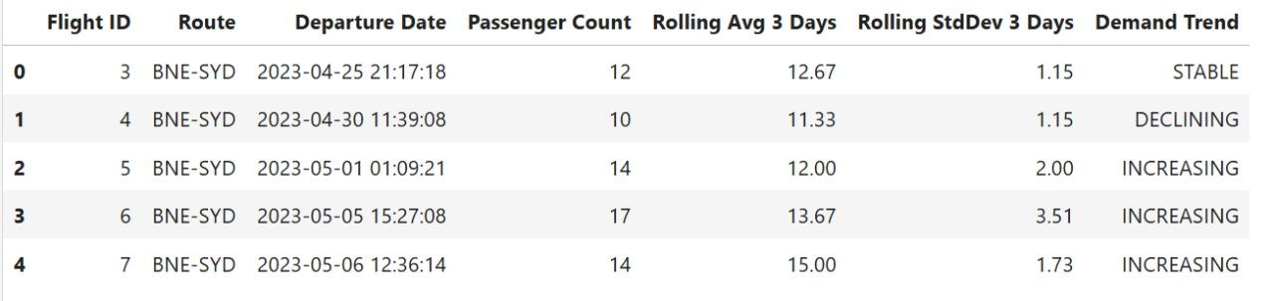
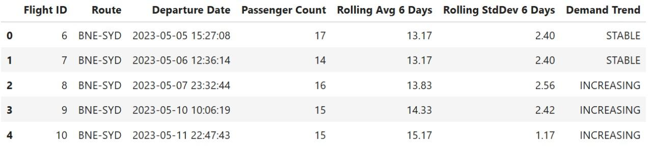

Slide 10
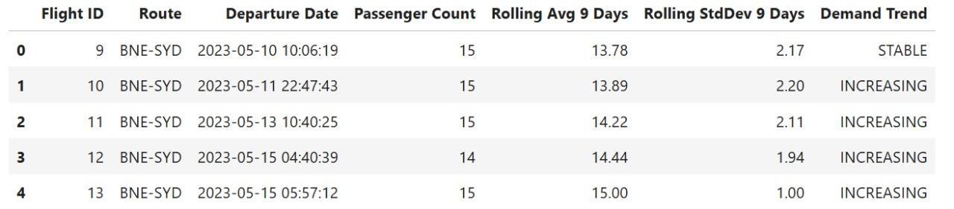

Slide 11
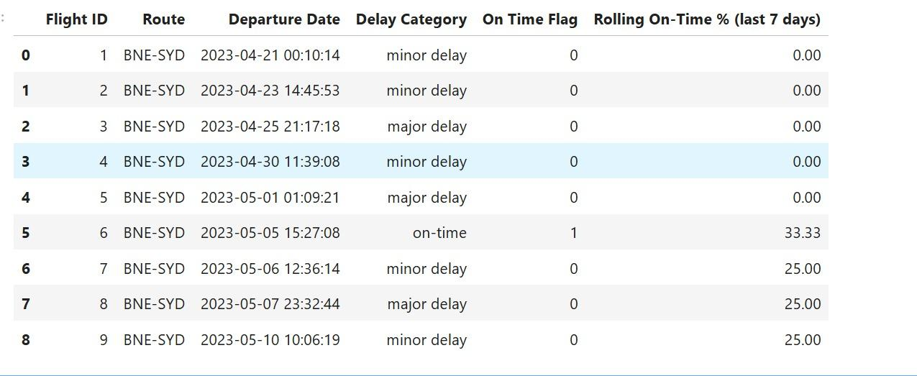
TASK 3
Adding 2 columns
Using CASE in order to set delay category on duration of each delay
To create time flag use CASE, if duration of delay is up to 15 minutes we set 1, 0 otherwise
Then we create a new table with the most significant columns from flights_schedule to calculate rolling on time %. (the number in column "Rolling On-Time % (last 7 days)" shows the fraction of flights on time)

